Slide 1
So What Kind of Future do we Want?
What do we want to sustain?
For whom?
For how long?
How can education contribute to the future we want?
Notes:
1

Slide 2
Sustainability
“The possibility that human and other life
will flourish on the planet forever”
John R. Ehrenfeld

Slide 3
Sustainability
"A sustainable society
is one that is far-seeing enough,
flexible enough, and wise enough
not to undermine either its physical
or its social systems of support.”
Donella Meadows

Slide 4
Education for Sustainability
“An education that prepares people
to be far-seeing enough,
flexible enough, and wise enough
to contribute
to the regenerative capacity
of the physical and social systems
upon which they depend.”
Jaimie P. Cloud

Slide 5
Imagine
There is a shared understanding
that schools have a responsibility to contribute
to our individual and collective potential,
and to that of the living systems
upon which all life depends.

Slide 6
Imagine
Schools are learning organizations.

Slide 7
Imagine
The potential of having all our children in school with their teachers and mentors during the most favorable time for learning…

Slide 8
Imagine
…and that we honor them with transformative learning experiences that prepare them to participate in,
and to lead with us
the shift toward a sustainable future.

Slide 9
Think About It
Every sector
food, buildings, business, government,
higher education, urban and rural planning…
is making the shift toward sustainability
and even regeneration.
Where do they think they are going without all the children, young people and their teachers?

Slide 10
Why Educate for Sustainability?
We have to learn how to live well in our places without undermining their ability
to sustain us over time.
The foundations of our knowledge, skills, and
habits of mind are cultivated in our schools.
Notes:
10

Slide 11
Questions to Consider
What are we already doing?
What might we want to change?
What do we need to stop doing?
What do we need to start doing?
Notes:
11

Slide 12
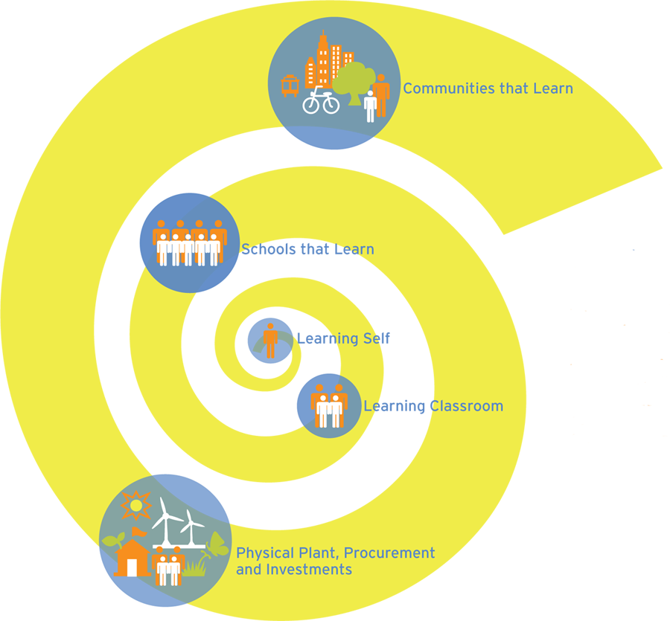
The Cloud Institute
Education for Sustainability Framework

Slide 13
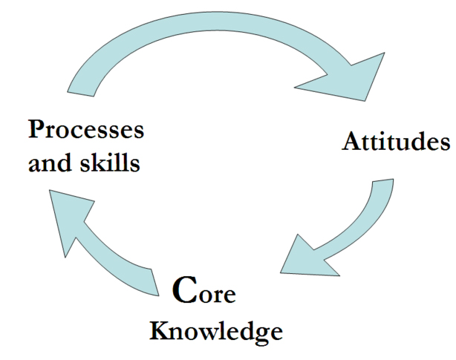
The Learning Self
Notes:
13

Slide 14
The Learning Self
Core Attitudes
Ethics
Mindfulness
Compassion
Brain & Mind
Multiple Intelligences
Potential
&
Purpose
Personal Story
Motivation
Learning Styles
Sense of Self
Empathy

Slide 15
The Learning Self
Core Processes and Skills
Applied Systems Thinking
Participation & Leadership
Visioning, Lateral Thinking & Creativity
Deep Learning
& Deep Thinking
Engaging Diversity

Slide 16
The Learning Self Core Knowledge
Cultural Preservation and Transformation
Responsible Local/ Global Citizenship
Strong Sense of Place
Dynamics of Systems and Change
Multiple Perspectives
Sustainable Economics
Inventing and Affecting the Future
Healthy Commons
Natural Laws and Ecological Principles

Slide 17
The Learning Classroom
Class as a Learning Community
Constructivist Approach to Teaching
Technology Integration
Authentic Instruction & Assessment
Place-Based
Learner-Centered
Inquiry-based
Standards Driven
Project-Based
Reflective Practice
Interdisciplinary
Differentiated
Cooperative Learning
Applied Learning
Writing Process
Assessment-Driven
Service Learning
Understanding by Design

Slide 18
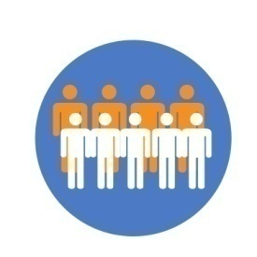
Schools that Learn for EfS
In schools that learn, everyone is encouraged to keep thinking, innovating, collaborating, talking candidly, improving their capabilities, self-correcting, and making personal commitments
to a shared future…

Slide 19
Physical Plant, Procurement,
and Investments for EfS
Green buildings, regenerative designs, green rooftops, no waste, energy efficiency, use of regional materials, healthiness, cost savings, recycled materials, social and environmental responsibility…

Slide 20
Communities that Learn
for EfS
Everyone
(businesses, local government, community members, etc.)
is encouraged to keep thinking, innovating, collaborating, talking candidly, improving their capabilities, self-correcting, and making personal commitments to a shared future…

Slide 21
Aligned Frameworks
Common Core Standards
Character Education
Understanding by Design (Wiggins)
Growth Mindset (Dweck)
The Entrepreneurial Mindset
Partnership for 21st Century Skills (Kay)
Cultural Competency (Steven Jones)
Social-Emotional Intelligence Attributes (Goleman)
Habits of Mind (Costa and Kallick)
Whole New Mind (Daniel Pink)
Neuro-Leadership (David Rock)

Slide 22
The Cloud Institute

Slide 23
The Cloud Institute at Work
Awareness
Skill Development
Design
Leadership
Consulting and Coaching Services
Curriculum Design & Mapping
Gap/Strength Assessment & Analysis
Organizational Learning & Change
Leadership Development
Curriculum Materials
Units of Study
Full Courses of Study
Assessment Tools
Professional Development
Research and Development
Notes:
23

Slide 24
Contact Information
www.cloudinstitute.org/contact-us
Notes:
24

